Slide 1
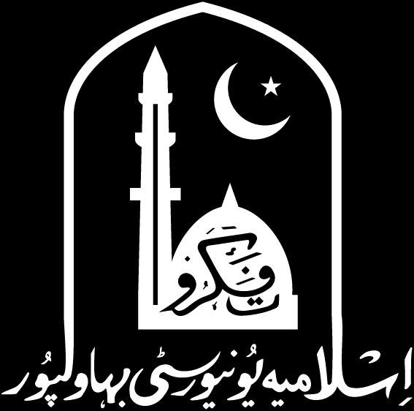

Graphs: Representation, Traversal and Sparsity
18
PART V · GRAPH ALGORITHMS
CHAPTER 18 · WEEK 13
Design, Proof and Measurement
LECTURER
Dr. Mustafa Hameed
THE ISLAMIA UNIVERSITY OF BAHAWALPUR
Bahawalpur, Pakistan
Department of Information Technology · BSIT · Fall 2026
Notes:
Chapter 18: Graphs: Representation, Traversal and Sparsity. Part 5 — Graph Algorithms. Week 13: Graph representation, traversal and spanning trees. Handout pages 147–153.

Slide 2

Where this chapter sits
THE COURSE
PART I
PART II
PART III
PART IV
PART V
PART VI
1
2
3
4
5
6
7
8
9
10
11
12
13
14
15
16
17
18
19
20
21
22
23
Graphs: Representation, Traversal and Sparsity
BUILDS ON
USED LATER IN
Ch 2 Input Size, Input Nature, and the Three Cases
Ch 19 Minimum Spanning Trees
Ch 12 Heaps and Search Trees, Revisited for Analysis
Ch 20 Shortest Paths: Single-Source and All-Pairs
Ch 23 The Semester Project
Analysis of Algorithms · Chapter 18 · Graphs: Representation, Traversal and Sparsity
Handout p. 147 2
Notes:
Place the chapter. Before you start: Chapter 2 for the two-parameter bound, Chapter 12 for the queue and stack. No Part IV material is required.

Slide 3

What you will be able to do
LEARNING OUTCOMES
By the end of this chapter you will be able to:
1
Compare the adjacency matrix and adjacency list on space, edge-test cost and neighbour-sweep cost.
2
Derive the running time of BFS and DFS from each representation, and explain why the bound is quoted in two parameters.
3
Define sparse and dense, and predict which representation wins for a given density (CLO-2).
4
Apply BFS to find shortest paths in an unweighted graph and DFS to produce a topological order (CLO-7).
5
Account for a measured result that contradicts the textbook prediction.
Analysis of Algorithms · Chapter 18 · Graphs: Representation, Traversal and Sparsity
Handout p. 147 3
Notes:
Read these out: they are the chapter's contract with the room. Each click adds one.

Slide 4

Vocabulary for this chapter
KEY TERMS
graph
vertex
edge
directed
undirected
adjacency matrix
adjacency list
sparse
dense
density
degree
breadth-first search
depth-first search
topological order
bit-packing
Each term is defined where it first matters — not here.
Analysis of Algorithms · Chapter 18 · Graphs: Representation, Traversal and Sparsity
Handout p. 147 4
Notes:
Do not define these now; they arrive one at a time. This slide is for the students' notes. Terms: graph; vertex; edge; directed; undirected; adjacency matrix; adjacency list; sparse; dense; density; degree; breadth-first search; depth-first search; topological order; bit-packing.

Slide 5
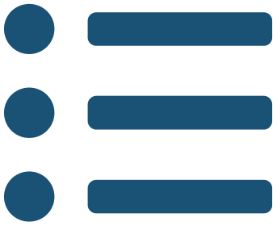
In this chapter
IN THIS CHAPTER
18.1
Why Every Bound Here Has Two Parameters
p. 147 ›
18.2
Two Representations
p. 148 ›
18.3
Breadth-First Search
p. 148 ›
18.4
Measured: Where the Textbook Prediction Fails
p. 149 ›
Analysis of Algorithms · Chapter 18 · Graphs: Representation, Traversal and Sparsity
Handout pp. 147–153 5
Notes:
The route through the chapter. Each row is a link: click it to jump to that section in the slide show.

Slide 6
Why Every Bound Here Has Two Parameters
SECTION 1 OF 4
18.1
18.1 Why Every Bound Here Has Two Parameters
18.2 Two Representations
18.3 Breadth-First Search
18.4 Measured: Where the Textbook Prediction Fails
Analysis of Algorithms · Chapter 18
Handout §18.1 6
Notes:
Pause. Name the question this section answers.

Slide 7

Density, Sparse and Dense
DEFINITION
G is sparse when |E| = O(|V|) — each vertex has a bounded average degree — and dense when |E| = Θ(|V|²).
Analysis of Algorithms · Chapter 18 · Graphs: Representation, Traversal and Sparsity
§18.1 · Handout p. 147 7
Notes:
Read the box aloud, then ask for an example from the room before moving on.

Slide 8

The same bound, two different answers
CONCEPT
Chapter 2 made this point with a road network and a social graph; it is worth restating now that the algorithms are at hand.
BFS is O(|V| + |E|) from an adjacency list. On a road network with 2 million junctions and average degree 3, that is 5 × 10⁶ steps. On a social graph with the same vertex count and average degree 500, it is 5 × 10⁸ — a hundred times more, for the same algorithm at the same |V|.
This is why O(|V|²) and O(|V| + |E|) must be distinguished even though they are equal on dense graphs. The first says nothing about sparsity; the second says you have exploited it.
Analysis of Algorithms · Chapter 18 · Graphs: Representation, Traversal and Sparsity
§18.1 · Handout p. 147 8
Notes:
Read the box aloud, then ask for an example from the room before moving on.

Slide 9
Two Representations
SECTION 2 OF 4
18.2
18.1 Why Every Bound Here Has Two Parameters
18.2 Two Representations
18.3 Breadth-First Search
18.4 Measured: Where the Textbook Prediction Fails
Analysis of Algorithms · Chapter 18
Handout §18.2 9
Notes:
Pause. Name the question this section answers.

Slide 10
Adjacency Matrix and Adjacency List
DEFINITION
The adjacency matrix is a |V| × |V| array A with A[u][v] = 1 exactly when (u,v) is an edge.
The adjacency list stores, for each vertex, a list of its neighbours.
 | Matrix | List
space | Θ(|V|²) | Θ(|V| + |E|)
“is (u,v) an edge?” | Θ(1) | O((u))
list u’s neighbours | Θ(|V|) | Θ((u))
add an edge | Θ(1) | Θ(1)
BFS or DFS | Θ(|V|²) | Θ(|V|+|E|)
The third row is the one that decides traversals. A matrix must read all |V| entries of a row to find a vertex’s neighbours, whether it has 2 or 2,000.
Analysis of Algorithms · Chapter 18 · Graphs: Representation, Traversal and Sparsity
§18.2 · Handout p. 148 10
Notes:
Read the box aloud, then ask for an example from the room before moving on.

Slide 11

Space, Which Usually Decides First
WORKED EXAMPLE
Average degree 8 — a sparse graph:
|V| | matrix (MB) | list (MB) | ratio
1,000 | 1.0 | 0.04 | 25
4,000 | 15.3 | 0.15 | 100
16,000 | 244.1 | 0.61 | 400
64,000 | 3,906.2 | 2.44 | 1,600
At 64,000 vertices the matrix needs 3.9 GB and the list needs 2.4 MB. The ratio grows as |V|, because the matrix is quadratic and the list linear.
For most real graphs this table ends the discussion before any timing is done. A social network with ten million users cannot be stored as a matrix on any machine — 10¹⁴ bytes — and can be stored as a list in a few gigabytes.
Analysis of Algorithms · Chapter 18 · Graphs: Representation, Traversal and Sparsity
§18.2 · Handout p. 148 11
Notes:
Each click adds one step of the working. Ask for the next number before you reveal it.

Slide 12
Breadth-First Search
SECTION 3 OF 4
18.3
18.1 Why Every Bound Here Has Two Parameters
18.2 Two Representations
18.3 Breadth-First Search
18.4 Measured: Where the Textbook Prediction Fails
Analysis of Algorithms · Chapter 18
Handout §18.3 12
Notes:
Pause. Name the question this section answers.

Slide 13
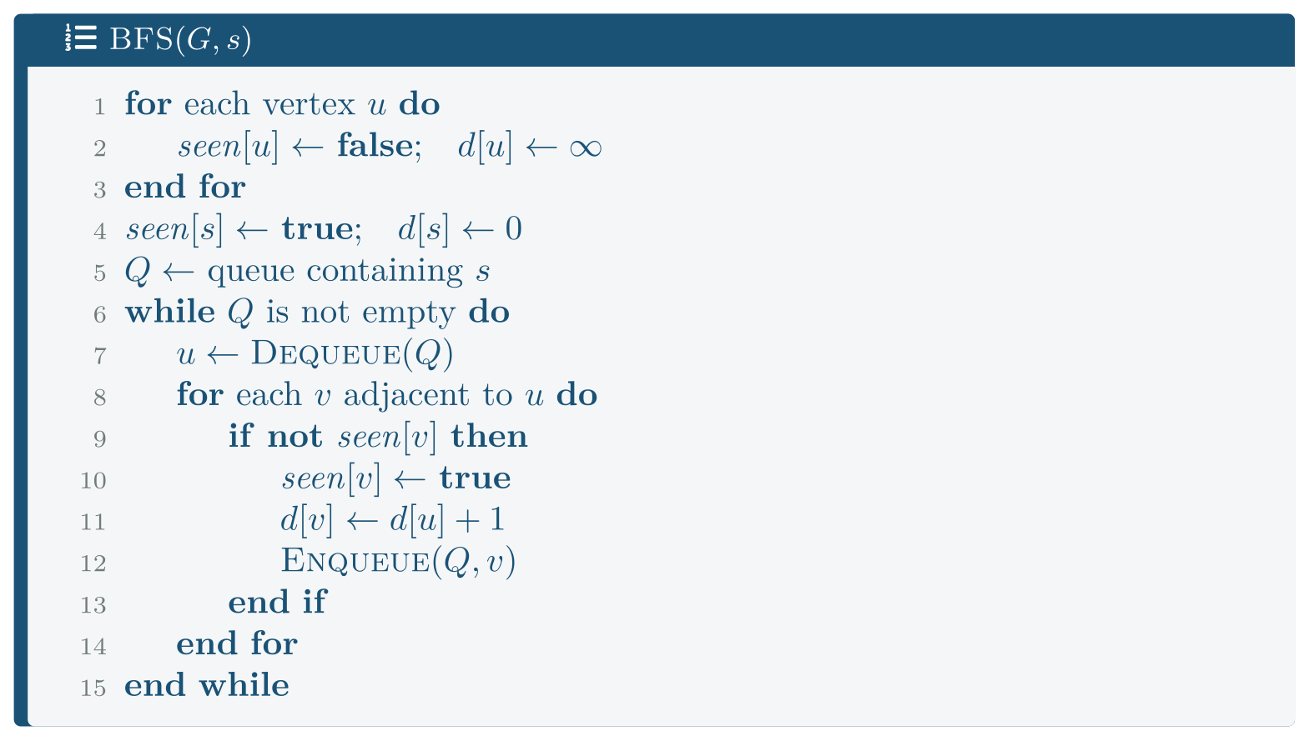
Breadth-First Search
FIGURE 18.1
BFS. Line 7 — “for each v adjacent to u” — is the only line whose cost depends on the representation, and it is the whole of the asymptotic difference.
Analysis of Algorithms · Chapter 18 · Graphs: Representation, Traversal and Sparsity
§18.3 · Handout p. 148 13
Notes:
Figure 18.1 (handout p. 149): BFS. Line 7 — “for each v adjacent to u” — is the only line whose cost depends on the representation, and it is the whole of the asymptotic difference.

Slide 14

BFS
THEOREM 18.1
BFS runs in Θ(|V| + |E|) from an adjacency list, and d[v] is the number of edges on a shortest path from s to v.
Analysis of Algorithms · Chapter 18 · Graphs: Representation, Traversal and Sparsity
§18.3 · Handout p. 148 14
Notes:
Proof. Time. Each vertex is enqueued at most once, since seen is set when it is, so the while loop iterates at most |V| times. For each dequeued u the inner loop runs (u) times, and Σᵤ (u) = 2|E|. With the Θ(|V|) initialisation this gives Θ(|V|+|E|). Correctness. Invariant: the queue holds vertices of distance k followed by vertices of distance k+1, for some k, and d is correct for every vertex already dequeued. Initially the queue holds s alone with d[s]=0. When u at distance k is dequeued, each unseen neighbour v gets d[v] = k+1; this is correct because a shortest path to v cannot be shorter than k+1 (its predecessor would then have distance < k and v would already have been seen, as all such vertices were dequeued earlier), and it is achievable via u. The vertices appended therefore all have distance k+1, preserving the invariant.

Slide 15
DFS, and what it is for
CONCEPT
Depth-first search replaces the queue with a stack (or recursion) and is also Θ(|V|+|E|). It is not an alternative way to visit vertices; it computes different things.
• BFS gives shortest paths in an unweighted graph, and the layer structure. Chapter 20 generalises it to weights.
• DFS gives a topological order — reverse order of finishing times, for a directed acyclic graph — and detects cycles, finds strongly connected components, and identifies articulation points. All of these depend on the timing of the recursion, which BFS does not have.
A practical warning carried from Chapter 9: recursive DFS on a graph with a long path uses Θ(|V|) stack frames. On a million-vertex graph that is a stack overflow, and the fix is an explicit stack.
Analysis of Algorithms · Chapter 18 · Graphs: Representation, Traversal and Sparsity
§18.3 · Handout p. 148 15
Notes:
Read the box aloud, then ask for an example from the room before moving on.

Slide 16
Measured: Where the Textbook Prediction Fails
SECTION 4 OF 4
18.4
18.1 Why Every Bound Here Has Two Parameters
18.2 Two Representations
18.3 Breadth-First Search
18.4 Measured: Where the Textbook Prediction Fails
Analysis of Algorithms · Chapter 18
Handout §18.4 16
Notes:
Pause. Name the question this section answers.

Slide 17
BFS Across Densities
WORKED EXAMPLE
|V| = 8,000 fixed; only the edge count varies. code/ch18_graphs.cpp:
avg degree | |E| | matrix (ms) | list (ms) | speed-up
2 | 8,000 | 61.46 | 0.17 | 353.4
8 | 32,000 | 76.37 | 0.27 | 278.8
64 | 256,000 | 79.60 | 0.88 | 90.5
256 | 1,024,000 | 94.06 | 3.02 | 31.2
1024 | 4,096,000 | 152.53 | 10.15 | 15.0
The matrix column is nearly flat — 61 to 153 ms while the edge count grows 512-fold. That is Θ(|V|²) made visible: the work does not depend on |E| at all, because every row is read in full regardless.
The list column grows with |E|, from 0.17 to 10.15 ms, which is Θ(|V|+|E|).
On a sparse graph the list is 353× faster. For a road network or a social graph that is the entire argument.
Analysis of Algorithms · Chapter 18 · Graphs: Representation, Traversal and Sparsity
§18.4 · Handout p. 149 17
Notes:
Each click adds one step of the working. Ask for the next number before you reveal it.

Slide 18
A Result That Contradicted the Textbook, and Why
WORKED EXAMPLE
The standard claim is that the matrix wins on dense graphs, since Θ(|V|²) and Θ(|V|+|E|) agree there. The first version of this experiment found otherwise — the list won at every density, up to 95% of complete.
The cause was the representation of the representation. A matrix stored one byte per potential edge reads |V|² bytes and tests each with an unpredictable branch. Stored one bit per potential edge it reads |V|²/8 bytes and can test 64 candidates in a single word operation. That bit-packing is the real reason matrices are recommended for dense graphs, and leaving it out made the comparison unfair.
With the bit-packed matrix, |V| = 4,000:
Analysis of Algorithms · Chapter 18 · Graphs: Representation, Traversal and Sparsity
§18.4 · Handout p. 149 18
Notes:
Each click adds one step of the working. Ask for the next number before you reveal it.

Slide 19
A Result That Contradicted the Textbook, and Why (continued)
WORKED EXAMPLE
avg deg | density | byte matrix | bit matrix | list | winner
512 | 0.128 | 39.87 | 4.31 | 2.86 | list
1,024 | 0.256 | 58.93 | 5.13 | 5.02 | tied
2,048 | 0.512 | 92.65 | 8.68 | 11.31 | bit matrix
3,000 | 0.750 | 107.16 | 10.51 | 17.43 | bit matrix
3,990 | 0.998 | 97.06 | 13.59 | 22.85 | bit matrix
The crossover is at a density of about 0.26, and the textbook claim is vindicated — but only for the bit-packed matrix, which is 7× faster than the byte one at high density.
Analysis of Algorithms · Chapter 18 · Graphs: Representation, Traversal and Sparsity
§18.4 · Handout p. 149 19
Notes:
Each click adds one step of the working. Ask for the next number before you reveal it.

Slide 20
A Result That Contradicted the Textbook, and Why (continued)
WORKED EXAMPLE
There is a second lesson buried in the first attempt. The bit-packed version was slower than the byte version until its bit-scan was fixed: finding the index of the lowest set bit with a shift loop costs up to 64 iterations per edge, and the processor has a single instruction that does it. One line of code moved the bit matrix from 115 ms to 8.7 ms at density 0.512.
Both lessons are the same lesson. “Adjacency matrix” and “adjacency list” name data structures; they do not name implementations, and the gap between a good and a poor implementation of the same structure was larger here than the gap between the two structures.
Analysis of Algorithms · Chapter 18 · Graphs: Representation, Traversal and Sparsity
§18.4 · Handout p. 149 20
Notes:
Each click adds one step of the working. Ask for the next number before you reveal it.

Slide 21
The One Thing the Matrix Is Better At
WORKED EXAMPLE
“Is (u,v) an edge?” — ten million random queries:
avg degree | matrix (ms) | list (ms) | list/matrix
4 | 74.9 | 146.0 | 1.9
32 | 74.3 | 349.4 | 4.7
256 | 78.9 | 2,218.7 | 28.1
The matrix is flat and the list grows with degree, exactly as Θ(1) against O((u)) predicts. At average degree 256 the matrix is 28× faster.
So the choice is not “lists are better”. It is:
• traversal-heavy, sparse ⇒ adjacency list;
• edge-query-heavy, or dense and small ⇒ matrix, bit-packed;
• both ⇒ keep a list for traversal and a hash set of edges for queries, which is what most real graph libraries do.
Analysis of Algorithms · Chapter 18 · Graphs: Representation, Traversal and Sparsity
§18.4 · Handout p. 149 21
Notes:
Each click adds one step of the working. Ask for the next number before you reveal it.

Slide 22

Common pitfalls
COMMON PITFALLS
✕
Quoting O(|V|²) when you mean O(|V|+|E|). They differ by a factor of |V| on a sparse graph — measured, 353.
✕
Using a matrix for a large sparse graph. 3.9 GB against 2.4 MB at |V| = 64,000.
✕
Using a byte-per-entry matrix on a dense graph. Measured 7× slower than bit-packing, which is the only reason to choose a matrix at all.
✕
Finding the lowest set bit with a loop. It cost more than the entire rest of the traversal.
✕
Recursive DFS on a large graph. Θ(|V|) stack frames; use an explicit stack.
✕
Using BFS for weighted shortest paths. It gives fewest edges, not least weight. Chapter 20 is the weighted case.
✕
Forgetting Σ_{u}(u) = 2|E|. It is what turns a sum over vertices into a bound in |E|, and it is the key step in Theorem 18.1.
Analysis of Algorithms · Chapter 18 · Graphs: Representation, Traversal and Sparsity
§18.4 · Handout p. 149 22
Notes:
For each pitfall, ask who has seen it happen. One real story beats five bullets.

Slide 23

Try it yourself: Representation, Measured
TRY IT YOURSELF
Reproduces all four tables. Expect thirty minutes.
WHAT YOU WILL DO
1. The two representations
2. The matrix, bit-packed
3. BFS from each representation
4. Space, which usually decides before speed does
5. BFS across a range of densities
6. Where is the crossover?
7. The trade, in two numbers
THIS WEEK'S LAB
WHAT YOU WILL RUN
RUNNABLE COPY
Week 13: The matrix/list crossover as density falls
1 listing, 53 lines of C++
code/ch18_graphs.cpp
Analysis of Algorithms · Chapter 18 · Graphs: Representation, Traversal and Sparsity
§18.4 · Handout p. 149 23
Notes:
Reproduces all four tables. Expect thirty minutes.

Slide 24
Representation, Measured
LAB · STEP 1 OF 8
The two representations
C++ · code/ch18_graphs.cpp
1
2
3
4
5
6
// ch18_graphs.cpp -- the representation decides the bound.
// Build: cl /O2 /EHsc /std:c++17 ch18_graphs.cpp (see Appendix A)
// --- 1. The two representations ------------------------------------
// The matrix is a vector<char> so one entry is one byte: V^2 bytes,
// which at V = 64,000 is already 3.9 GB.
Analysis of Algorithms · Chapter 18 · Graphs: Representation, Traversal and Sparsity
§18.4 · Handout p. 149 24
Notes:
Step 1: The two representations. Read the code aloud; ask what each line would print before running it.

Slide 25
Representation, Measured
LAB · STEP 2 OF 8
The matrix, bit-packed
C++ · code/ch18_graphs.cpp
8
9
10
11
12
13
14
15
16
17
18
19
20
// --- 2. The matrix, bit-packed -------------------------------------
// One BIT per potential edge rather than one byte, so V^2/8 bytes, and
// a whole 64-bit word of candidate neighbours tested at once. This is
// the real reason adjacency matrices are recommended for dense graphs,
// and without it the comparison is unfair to them.
struct BitMatrix {
size_t V, W; // W = words per row
std::vector<unsigned long long> a;
void add(size_t u, size_t w) {
a[u * W + (w >> 6)] |= 1ULL << (w & 63);
a[w * W + (u >> 6)] |= 1ULL << (u & 63);
}
};
Analysis of Algorithms · Chapter 18 · Graphs: Representation, Traversal and Sparsity
§18.4 · Handout p. 149 25
Notes:
Step 2: The matrix, bit-packed. Read the code aloud; ask what each line would print before running it.

Slide 26
Representation, Measured
LAB · STEP 3 OF 8
The matrix, bit-packed (continued)
C++ · code/ch18_graphs.cpp
22
23
24
25
26
27
28
29
30
31
32
33
34
35
36
37
// The bit-packed scan: skip 64 non-neighbours at a time, and within a
// word walk only the bits that are set.
while (bits) {
// The index of the lowest set bit, as ONE instruction.
// Finding it with a shift loop instead costs up to 64
// iterations per edge and makes the bit-packed matrix
// slower than the byte one -- which is what the first
// version of this program measured.
unsigned long idx;
_BitScanForward64(&idx, bits);
size_t w = wi * 64 + idx;
if (w < g.V && !seen[w]) {
seen[w] = 1; ++reached; q.push_back((unsigned)w);
}
bits &= bits - 1; // clear it
}
Analysis of Algorithms · Chapter 18 · Graphs: Representation, Traversal and Sparsity
§18.4 · Handout p. 149 26
Notes:
Step 3: The matrix, bit-packed (continued). Read the code aloud; ask what each line would print before running it.

Slide 27
Representation, Measured
LAB · STEP 4 OF 8
BFS from each representation
C++ · code/ch18_graphs.cpp
39
40
41
42
43
// --- 3. BFS from each representation -------------------------------
// The algorithms are identical. The only difference is how "for each
// neighbour of u" is implemented, and that is the whole gap.
for (size_t w = 0; w < g.V; ++w) // <-- Theta(V) per vertex
for (size_t i = g.start[u]; i < g.start[u+1]; ++i) // Theta(deg)
Analysis of Algorithms · Chapter 18 · Graphs: Representation, Traversal and Sparsity
§18.4 · Handout p. 149 27
Notes:
Step 4: BFS from each representation. Read the code aloud; ask what each line would print before running it.

Slide 28
Representation, Measured
LAB · STEP 5 OF 8
Space, which usually decides before speed does
C++ · code/ch18_graphs.cpp
45
// --- 4. Space, which usually decides before speed does -------------
Analysis of Algorithms · Chapter 18 · Graphs: Representation, Traversal and Sparsity
§18.4 · Handout p. 149 28
Notes:
Step 5: Space, which usually decides before speed does. Read the code aloud; ask what each line would print before running it.

Slide 29
Representation, Measured
LAB · STEP 6 OF 8
BFS across a range of densities
C++ · code/ch18_graphs.cpp
46
47
48
// --- 5. BFS across a range of densities ----------------------------
// V is FIXED. Only the number of edges changes, so the matrix version
// should take the same time throughout while the list grows with E.
Analysis of Algorithms · Chapter 18 · Graphs: Representation, Traversal and Sparsity
§18.4 · Handout p. 149 29
Notes:
Step 6: BFS across a range of densities. Read the code aloud; ask what each line would print before running it.

Slide 30
Representation, Measured
LAB · STEP 7 OF 8
Where is the crossover?
C++ · code/ch18_graphs.cpp
50
// --- 6. Where is the crossover? ------------------------------------
Analysis of Algorithms · Chapter 18 · Graphs: Representation, Traversal and Sparsity
§18.4 · Handout p. 149 30
Notes:
Step 7: Where is the crossover?. Read the code aloud; ask what each line would print before running it.

Slide 31
Representation, Measured
LAB · STEP 8 OF 8
The trade, in two numbers
C++ · code/ch18_graphs.cpp
51
52
53
// --- 7. The trade, in two numbers ----------------------------------
// The matrix answers "is there an edge u-w?" in one memory access.
// The list must scan u's neighbours.
Analysis of Algorithms · Chapter 18 · Graphs: Representation, Traversal and Sparsity
§18.4 · Handout p. 149 31
Notes:
Step 8: The trade, in two numbers. Read the code aloud; ask what each line would print before running it.

Slide 32
What the lab shows
TRY IT YOURSELF
What to notice. Part 5’s matrix column is flat while its list column grows 60-fold. Two columns of the same table, measuring the same algorithm on the same graphs, and one of them does not depend on |E| at all.
Then try to break it. Replace the compressed adjacency list with a vector of vectors — one separately allocated neighbour list per vertex — and re-measure part 5 at average degree 2. Predict the direction first. It will be slower, perhaps 2–3×, with identical asymptotics, because |V| separate allocations scatter the neighbour lists across memory and the prefetcher cannot follow. Same bound, same algorithm, different memory layout.
Analysis of Algorithms · Chapter 18 · Graphs: Representation, Traversal and Sparsity
§18.4 · Handout p. 149 32
Notes:
Read the box aloud, then ask for an example from the room before moving on.

Slide 33
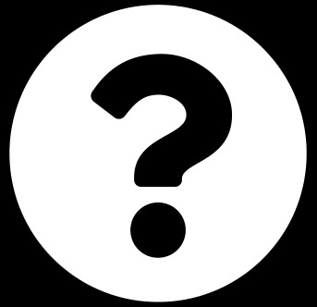
Explain why Σ_{u ∈ V} (u) = 2|E|, and where Theorem 18.1 uses it.
CHECKPOINT 1 OF 3
Discuss with the person next to you, then advance.
Analysis of Algorithms · Chapter 18 · Graphs: Representation, Traversal and Sparsity
Handout p. 153 · answers in Appendix D 33
Notes:
Ask the room. Do not advance until someone commits to an answer.

Slide 34

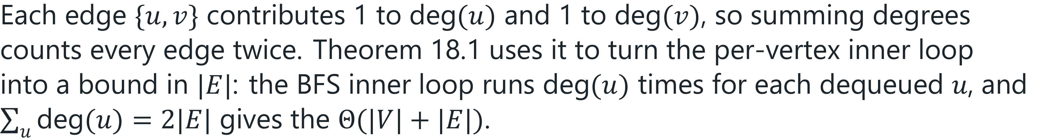
Explain why Σ_{u ∈ V} (u) = 2|E|, and where Theorem 18.1 uses it.
CHECKPOINT 1 OF 3 · ANSWER
Analysis of Algorithms · Chapter 18 · Graphs: Representation, Traversal and Sparsity
Handout p. 153 · answers in Appendix D 34
Notes:
Answer (Appendix D): Each edge {u,v} contributes 1 to (u) and 1 to (v), so summing degrees counts every edge twice. Theorem 18.1 uses it to turn the per-vertex inner loop into a bound in |E|: the BFS inner loop runs (u) times for each dequeued u, and Σu(u) = 2|E| gives the Θ(|V|+|E|).

Slide 35
A graph has |V| = 10⁶ and average degree 6. Give the space for both representations, and say which BFS bound applies to each.
CHECKPOINT 2 OF 3
Discuss with the person next to you, then advance.
Analysis of Algorithms · Chapter 18 · Graphs: Representation, Traversal and Sparsity
Handout p. 153 · answers in Appendix D 35
Notes:
Ask the room. Do not advance until someone commits to an answer.

Slide 36
A graph has |V| = 10⁶ and average degree 6. Give the space for both representations, and say which BFS bound applies to each.
CHECKPOINT 2 OF 3 · ANSWER
|E| = 3 × 10⁶. Matrix: |V|² = 10¹² bytes = 1 TB — impossible. List: about (10⁶ · 8) + (6 × 10⁶ · 4) ≈ 32 MB. BFS is Θ(|V|²) = 10¹² steps from the matrix and Θ(|V|+|E|) = 7 × 10⁶ from the list — a factor of 140,000, and the matrix cannot be built anyway.
Analysis of Algorithms · Chapter 18 · Graphs: Representation, Traversal and Sparsity
Handout p. 153 · answers in Appendix D 36
Notes:
Answer (Appendix D): |E| = 3 × 106. Matrix: |V|2 = 1012 bytes = 1 TB — impossible. List: about (106 · 8) + (6 × 106 · 4) ≈ 32 MB. BFS is Θ(|V|2) = 1012 steps from the matrix and Θ(|V|+|E|) = 7 × 106 from the list — a factor of 140,000, and the matrix cannot be built anyway.

Slide 37
The measured crossover was at density 0.26 for a bit-packed matrix and did not exist at all for a byte-packed one. What does that tell you about quoting crossover densities from a textbook (CLO-2)?
CHECKPOINT 3 OF 3
Discuss with the person next to you, then advance.
Analysis of Algorithms · Chapter 18 · Graphs: Representation, Traversal and Sparsity
Handout p. 153 · answers in Appendix D 37
Notes:
Ask the room. Do not advance until someone commits to an answer.

Slide 38
The measured crossover was at density 0.26 for a bit-packed matrix and did not exist at all for a byte-packed one. What does that tell you about quoting crossover densities from a textbook (CLO-2)?
CHECKPOINT 3 OF 3 · ANSWER
That a crossover density quoted without an implementation is meaningless. The same two data structures gave a crossover at 0.26 with one implementation of the matrix and no crossover at all with another, and the gap between a good and a poor implementation of the matrix (8–20×) was larger than the gap between the two structures. Quote the crossover for your code, measured.
Analysis of Algorithms · Chapter 18 · Graphs: Representation, Traversal and Sparsity
Handout p. 153 · answers in Appendix D 38
Notes:
Answer (Appendix D): That a crossover density quoted without an implementation is meaningless. The same two data structures gave a crossover at 0.26 with one implementation of the matrix and no crossover at all with another, and the gap between a good and a poor implementation of the matrix (8–20×) was larger than the gap between the two structures. Quote the crossover for your code, measured.

Slide 39

What to take away
CHAPTER SUMMARY
1
Graph bounds carry two parameters because |E| ranges from 0 to Θ(|V|²), and O(|V|+|E|) says you have exploited sparsity where O(|V|²) does not.
2
Matrix: Θ(|V|²) space, Θ(1) edge test, Θ(|V|) neighbour sweep. List: Θ(|V|+|E|) space, O() edge test, Θ() sweep.
3
BFS and DFS are both Θ(|V|+|E|) from a list and Θ(|V|²) from a matrix. BFS gives unweighted shortest paths; DFS gives topological order and cycle detection.
4
Measured: at |V| = 64,000, average degree 8, the matrix needs 3.9 GB and the list 2.4 MB.
5
Measured: with |V| fixed at 8,000, the matrix BFS time was flat (61–153 ms) while the list grew with |E| (0.17–10.15 ms). On the sparse graph the list was 353× faster.
6
Measured: the matrix wins on dense graphs only when bit-packed, with the crossover at density ≈ 0.26. A byte-per-entry matrix never won, and a bit-packed matrix with a naive bit-scan was slower still.
Analysis of Algorithms · Chapter 18 · Graphs: Representation, Traversal and Sparsity
Handout p. 153 39
Notes:
Ask the room to say each takeaway before you reveal it.

Slide 40
What to take away (continued)
CHAPTER SUMMARY
7
Measured: for single edge queries the matrix was flat and the list grew with degree — 28× slower at average degree 256.
Analysis of Algorithms · Chapter 18 · Graphs: Representation, Traversal and Sparsity
Handout p. 153 40
Notes:
Ask the room to say each takeaway before you reveal it.

Slide 41

Quick check 1 of 2
REVIEW · MULTIPLE CHOICE
BFS from an adjacency list runs in:
A
Θ(|V|)
B
Θ(|E|)
C
Θ(|V|+|E|)
D
Θ(|V|²)
Analysis of Algorithms · Chapter 18 · Graphs: Representation, Traversal and Sparsity
Handout p. 153 41
Notes:
Take a show of hands for each option before discussing. (The handout does not print MCQ answers.)

Slide 42
Quick check 2 of 2
REVIEW · MULTIPLE CHOICE
An adjacency matrix for a graph with |V| = 10⁵ requires about:
A
100 KB
B
10 MB
C
10 GB
D
1 TB
Analysis of Algorithms · Chapter 18 · Graphs: Representation, Traversal and Sparsity
Handout p. 153 42
Notes:
Take a show of hands for each option before discussing. (The handout does not print MCQ answers.)

Slide 43
For your notebook
REVIEW QUESTIONS
SHORT
Define sparse and dense, and say which representation suits each and why (CLO-2).
SHORT
Give one task BFS does that DFS does not, and one that DFS does that BFS does not (CLO-7).
SHORT
The measured matrix BFS time barely changed as |E| grew 512-fold. Explain.
APPLIED
Prove that DFS on a directed acyclic graph, emitting vertices in reverse order of finishing time, produces a topological order.
APPLIED
You are choosing a representation for a graph of 50 million web pages with average out-degree 40, for a workload that is 90% traversal and 10% edge queries. Decide, giving the arithmetic, and say what you would measure to check.
Analysis of Algorithms · Chapter 18 · Graphs: Representation, Traversal and Sparsity
Handout p. 153 43
Notes:
Set these for independent study. Model answers are not printed in the handout.

Slide 44
End of Chapter 18
18
NEXT
READ
Chapter 19 — Minimum Spanning Trees
Handout Chapter 18, pages 147–153
THIS WEEK'S LAB
ASSESSMENT
The matrix/list crossover as density falls
Assignment 2 set; project proposal
Analysis of Algorithms · Chapter 18 · Graphs: Representation, Traversal and Sparsity
44
Notes:
Close. NEXT: Chapter 19 — Minimum Spanning Trees. READ: Handout Chapter 18, pages 147–153. THIS WEEK'S LAB: The matrix/list crossover as density falls. ASSESSMENT: Assignment 2 set; project proposal.

